Slide 1
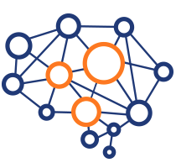
Introduction to Neural Networks
Learning like a human
Yordan Darakchiev
Technical Trainer
iordan93@gmail.com

Slide 2
Table of Contents
sli.do: #neural-nets
Neural networks – overview, problem statement
Pros and cons
Perceptron
Feed-forward NNs (multi-layer perceptrons)
Training, applications for classification
Convolutional neural networks – overview

Slide 3
Perceptron
The basic unit

Slide 4
Neural Networks
Neural networks try to mimic the way the human brain works
Series of interconnected artificial neurons (perceptrons)
Can do classification, regression, unsupervised learning, etc.
Perceptrons were "invented" in the 1940s
Great development in the recent years
"Deep learning" – ML algorithms using neural networks
Cutting-edge applications
Machine translation
Speech recognition and generation
Image recognition
Game playing, etc.
Some examples of deep learning applications

Slide 5
Neural Networks: Pros and Cons
Can be used to model any datasets
Arbitrary dataset complexity
One type of algorithm can be used for many applications
Do not provide any interpretability
The classification boundaries are hard to interpret
The model is mostly "black box"
NNs are not probabilistic (we can't get a confidence metric)
"The Dark Secrets at the Heart of AI"
Solutions: trying to explain decisions, combining with other algorithms, etc.
Can be slow
Other models usually train a lot faster, even if we use special hardware
NNs are not a substitute for understanding the problem deeply

Slide 6
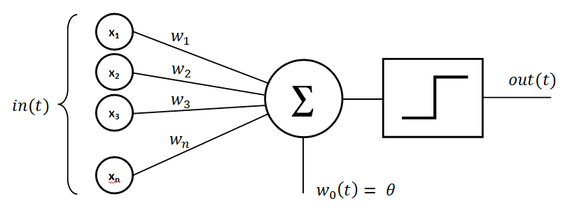
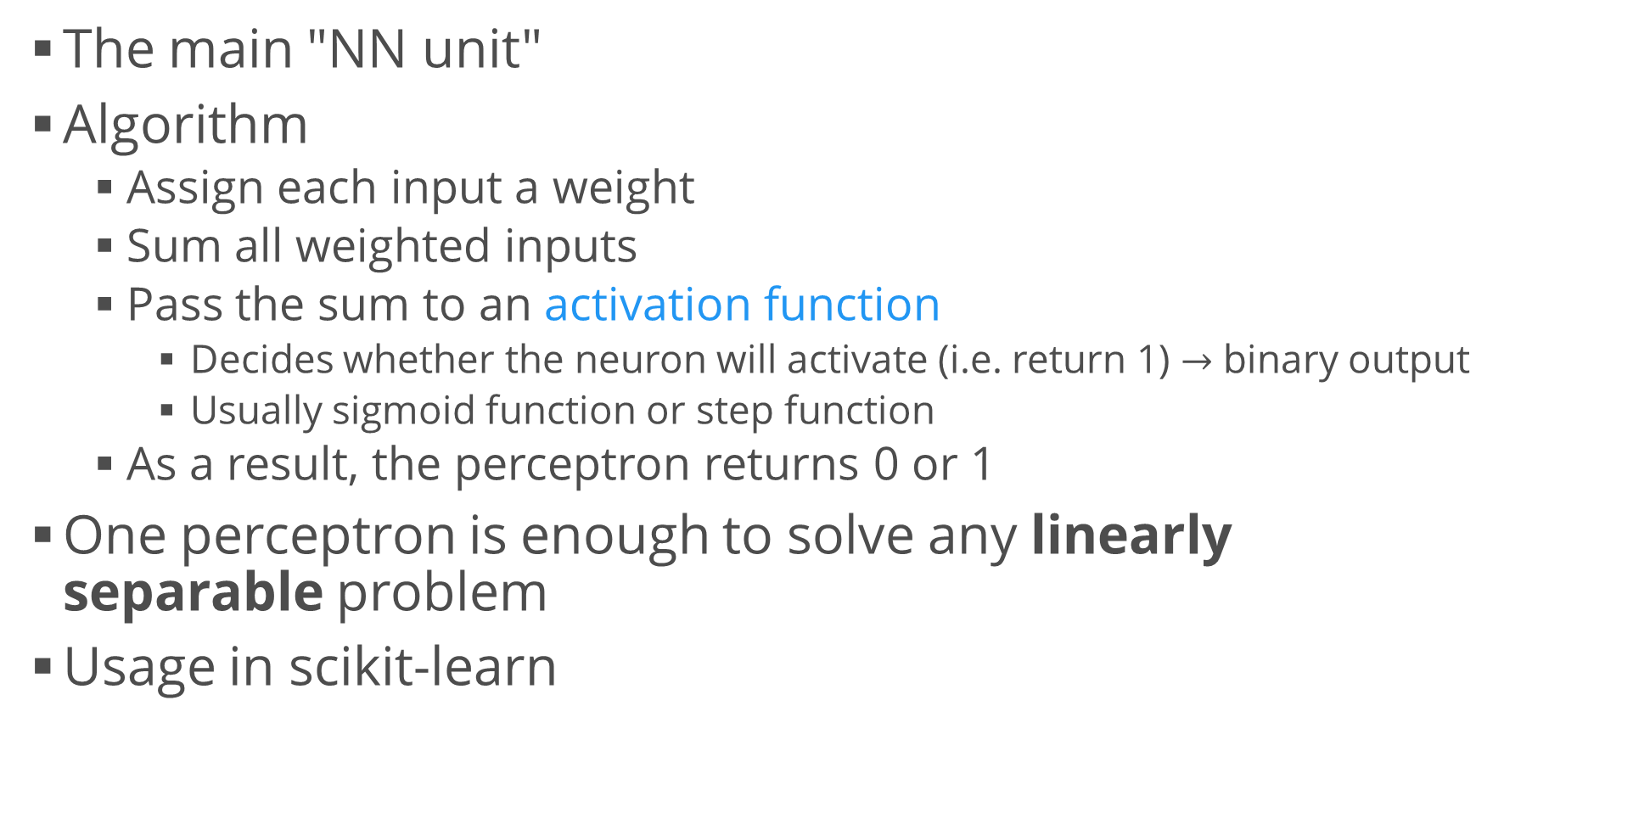
Perceptron
The main "NN unit"
Algorithm
Assign each input a weight
Sum all weighted inputs
Pass the sum to an activation function
Decides whether the neuron will activate (i.e. return 1) $→$ binary output
Usually sigmoid function or step function
As a result, the perceptron returns 0 or 1
One perceptron is enough to solve any linearly separable problem
Usage in scikit-learn
from sklearn.linear_model import Perceptron
perceptron = Perceptron()

Slide 7
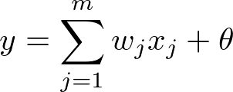

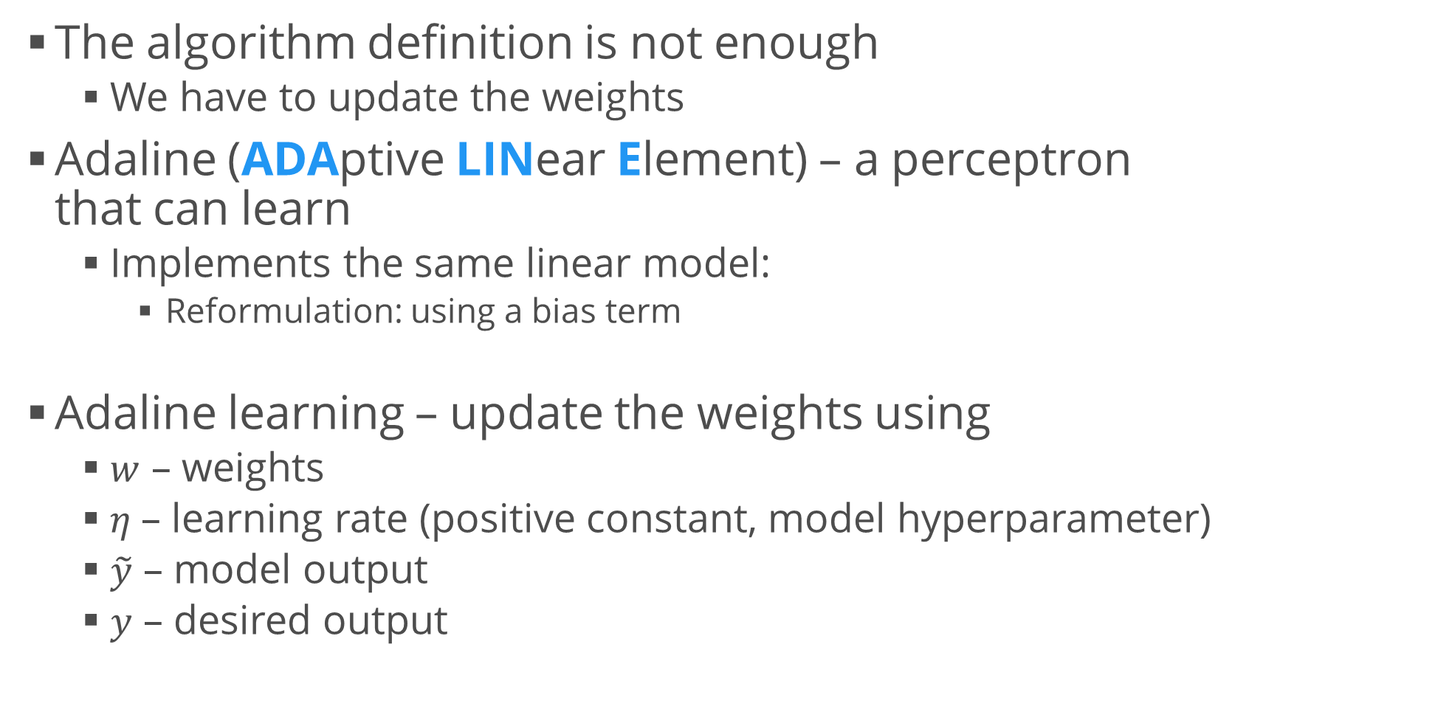
Perceptron Learning
The algorithm definition is not enough
We have to update the weights
Adaline (ADAptive LINear Element) – a perceptron that can learn
Implements the same linear model:
Reformulation: using a bias term
Adaline learning – update the weights using
$w$ – weights
$η$– learning rate (positive constant, model hyperparameter)
$\tilde{y}$ – model output
$y$ – desired output

Slide 8
Example: Perceptron
Generate 2D blobs using scikit-learn
Make sure they're linearly separable
Make sure you create enough samples, e.g. 10 000
Use a perceptron to classify samples as belonging to one blob or another
Test and score the performance
Score both in-sample and out-of-sample data
It's useful to compare the two metrics – this can sometimes detect underfitting or overfitting
Print a confusion matrix (and optionally, other metrics, e.g. ROC curve)
* Optionally, perform hyperparameter tuning
Especially if your blobs are too close

Slide 9
Neural Networks
Combining perceptrons to achieve glory

Slide 10
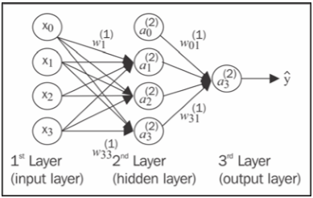
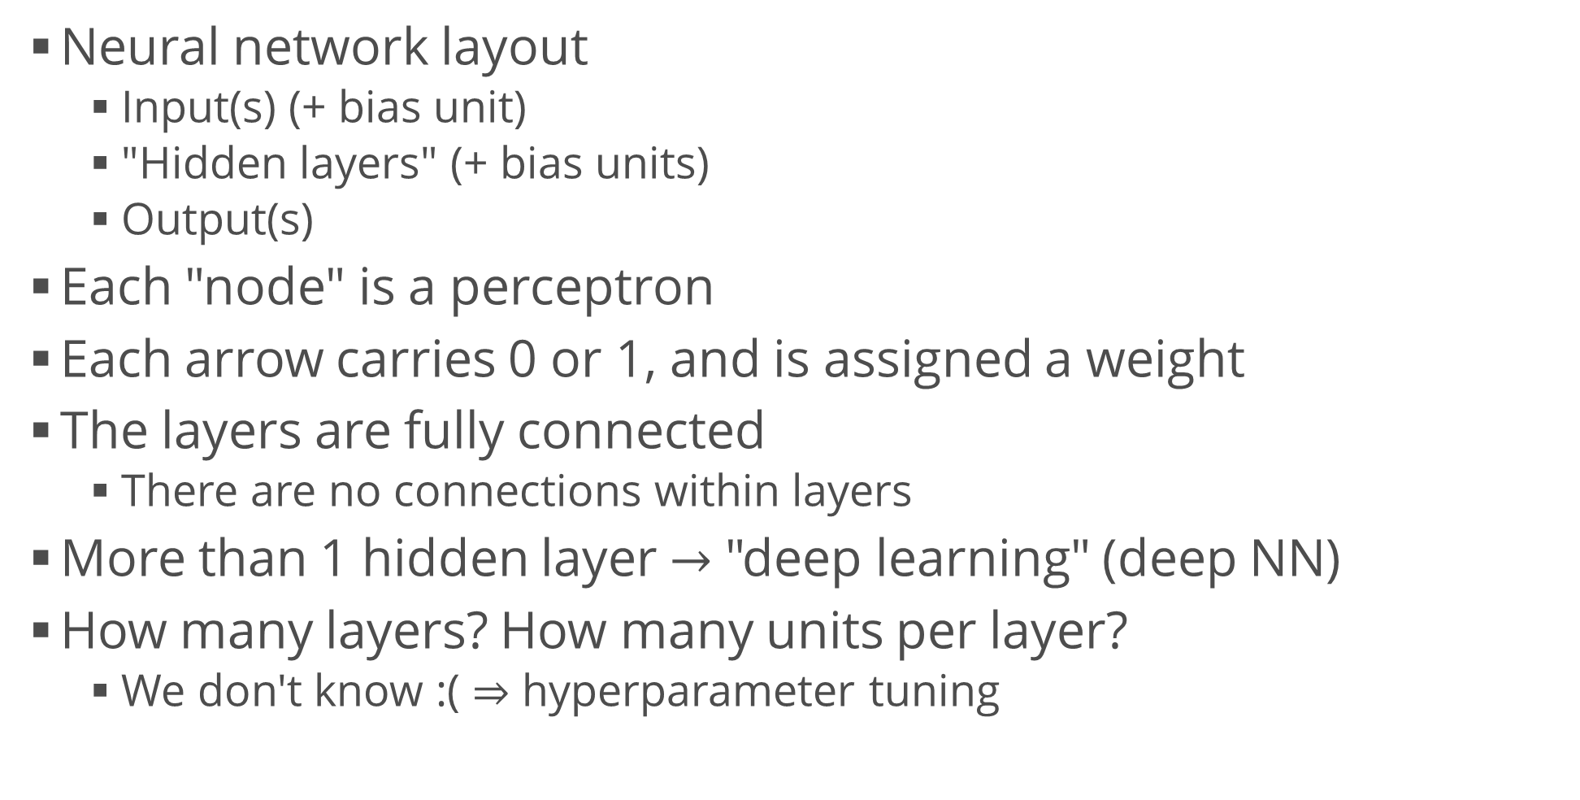
Neural Network Architecture
Neural network layout
Input(s) (+ bias unit)
"Hidden layers" (+ bias units)
Output(s)
Each "node" is a perceptron
Each arrow carries 0 or 1, and is assigned a weight
The layers are fully connected
There are no connections within layers
More than 1 hidden layer $→$ "deep learning" (deep NN)
How many layers? How many units per layer?
We don't know :( $⇒$ hyperparameter tuning

Slide 11
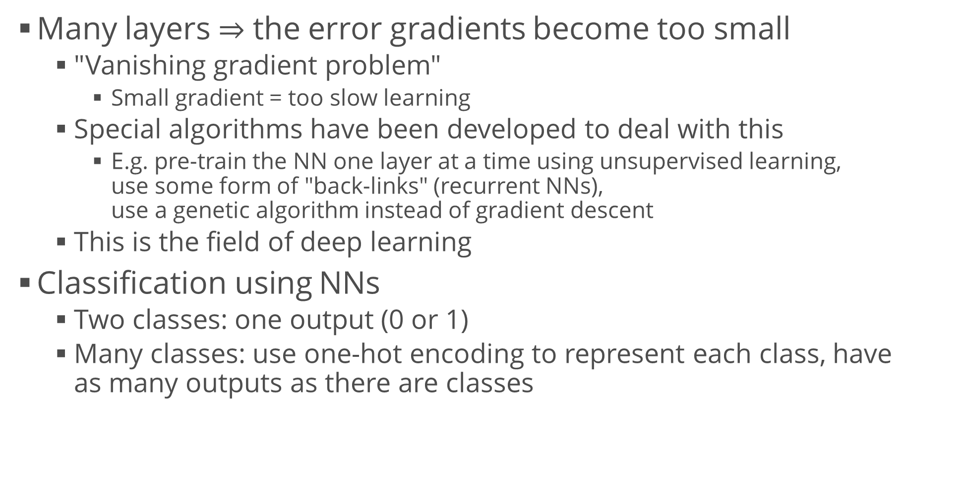
Neural Network Architecture (2)
Many layers $⇒$ the error gradients become too small
"Vanishing gradient problem"
Small gradient = too slow learning
Special algorithms have been developed to deal with this
E.g. pre-train the NN one layer at a time using unsupervised learning, use some form of "back-links" (recurrent NNs), use a genetic algorithm instead of gradient descent
This is the field of deep learning
Classification using NNs
Two classes: one output (0 or 1)
Many classes: use one-hot encoding to represent each class, have as many outputs as there are classes

Slide 12
Neural Network Learning
The type of NN we look at is called a "feed-forward NN"
Data flows only forward, there are no "back-links"
Learning algorithm:
Forward propagation / backpropagation
Using the data, propagate the patterns from input to output
Based on the output, calculate the error (using a cost function)
Backpropagate the error (using derivatives), update the model
We get the "final" weights after repeating the process for several epochs
The maths is a bit ugly
You can read an explanation here

Slide 13
Neural Network Learning (2)
Classification: just use one-hot encoding
MLP = multi-layer perceptron
Regression: no activation function at the output layer
Regularization: parameter alpha
Increasing = less overfitting
A visual comparison of regularization parameters
Tips
A neural network is very sensitive to feature scaling
[0; 1], [-1; 1] or Z
Use a scaler, e.g. StandardScaler
Use fine-tuning to optimize alpha
Usually in the range 10.0 ** -np.arange(1, 7)
from sklearn.neural_network import MLPClassifier
from sklearn.neural_network import MLPRegressor

Slide 14
Example: Classifying Handwritten Digits
Obtain the MNIST dataset of handwritten digits
This is a famous dataset for learning and comparing neural networks
Each data point represents a 28 x 28 image of a digit (0 – 9)
Train a simple NN on the MNIST dataset
Choose a reasonable number of layers and units per layer, e.g. {3, 3}
Test, score and evaluate the classification performance
E.g. accuracy, precision, recall, F1, confusion matrix, ROC curve
* Try several other architectures (e.g. more layers, more units per layer, different structure, e.g. 2 + 3 + 2 units, etc.)
* Compare the results with (an)other classifier(s), e.g. SVM

Slide 15
Convolutional Neural Networks
Feed-forward NNs inspired by the visual cortex
Very useful for working on images
Recognition and classification
Example: https://www.clarifai.com/demo
Main operations
Convolution
Non-linearity (ReLU – Rectified Linear Units)
Pooling (downsampling, subsampling)
Classification (fully-connected layer)
Idea: before proceeding to classification, perform image processing using convolution, pooling and ReLU
This process produces the input features of a classical NN

Slide 16
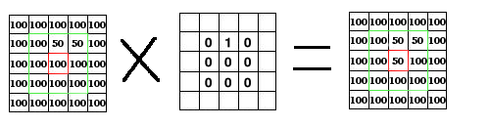
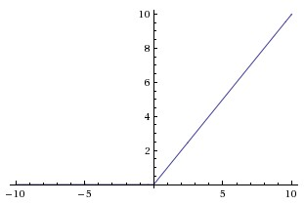
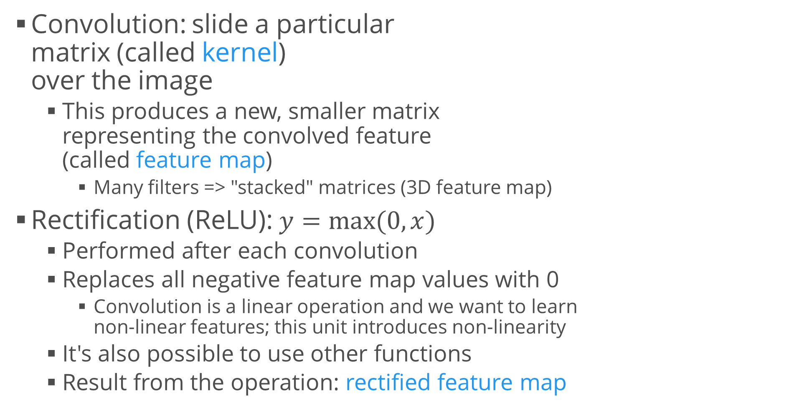
Convolutional Neural Networks (2)
Convolution: slide a particular matrix (called kernel) over the image
This produces a new, smaller matrix representing the convolved feature (called feature map)
Many filters => "stacked" matrices (3D feature map)
Rectification (ReLU): $y=max⁡(0, x)$
Performed after each convolution
Replaces all negative feature map values with 0
Convolution is a linear operation and we want to learn non-linear features; this unit introduces non-linearity
It's also possible to use other functions
Result from the operation: rectified feature map

Slide 17
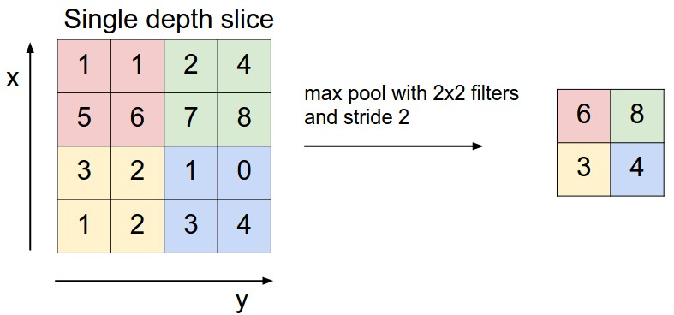
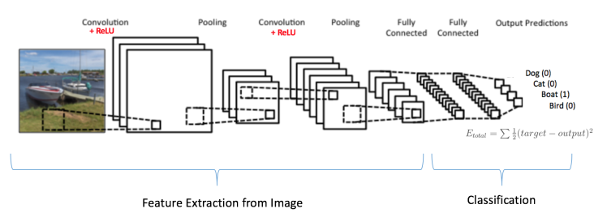
Convolutional Neural Networks (3)
Pooling (downsampling)
Reduces the feature map size
Types: max, average, sum, etc.
The function is applied to a "window" over the image
Stride: how many pixels to "skip"
The combination of convolution, ReLU and pooling layers should output a 1D number vector
Represents high-level features of the input image
Used as the input to a "standard" feed-forward NN
Called a fully-connected layer
The NN outputs the final result (e.g. image class)

Slide 18
Summary
Neural networks – overview, problem statement
Pros and cons
Perceptron
Feed-forward NNs (multi-layer perceptrons)
Training, applications for classification
Convolutional neural networks – overview

